Slide 1

DS307 · Bioinformatics
Bio-Forget
Privacy-Preserving Disease Detection
via Machine Unlearning on Genomic Sequences
Prof. Dr. Sahar Ghanem | Spring 2025–2026 | Deadline: April 24, 2026
Team of 10 · AI & CS

Slide 2
Agenda
Problem Statement & Motivation
Dataset Generation & GDPR Compliance
01
02
System Architecture & Workflow
Team Distribution & Roles
03
04
Machine Unlearning — SISA Algorithm
Privacy Verification (MIA)
05
06

Slide 3



Problem Statement
Key Question
Disease Detection
Can we make an AI model
"forget" a patient's genetic
data without retraining
from scratch?
AI models trained on raw DNA (FASTA) to detect Alzheimer's-related mutations (APOE4 SNPs).
Right to Be Forgotten
GDPR mandates patients can request deletion of their data from trained models.
The Challenge
Full model retraining is expensive. We need selective, efficient removal.
GDPR Art. 17

Slide 4
Dataset Generation
Simulated Alzheimer's Genomic Data — Biopython
2,000
150 bp
50 / 50
85%
Patient Sequences
Sequence Length
AD / Control Split
Marker Injection Rate
Alzheimer's Markers (APOE4)
Generation Pipeline
APOE4_rs429358
1. Start from 150 bp Reference Genome
TCCG
Pathogenic
2. Add 2–8 random benign SNPs (all samples)
APOE4_rs7412
CTCA
Pathogenic
3. Inject APOE4 markers at random positions (AD only)
4. Run alignment → count variants
5. Save FASTA + GDPR JSON registry

Slide 5
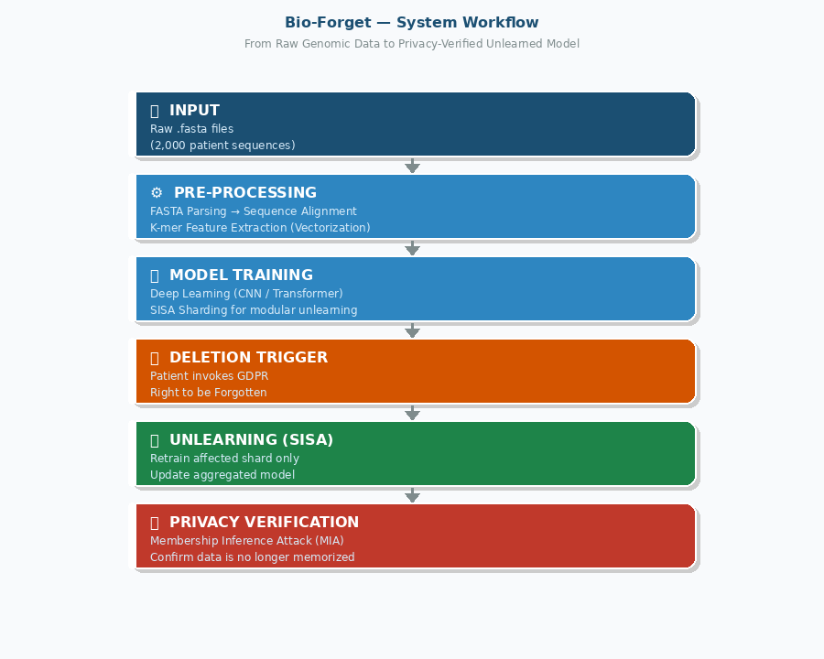
System Workflow
From Raw DNA to Privacy-Verified Unlearned Model

Slide 6








Team Distribution
Focus A — Data Engineering
Focus B — AI & Unlearning
FASTA Parsing
Model Development
High-speed parser for large .fasta files (Biopython)
CNN / Transformer for disease classification
Sequence Alignment
SISA Unlearning
BLAST/Bowtie2 mapping to reference genome
Sharded modular deletion without full retraining
K-mer Extraction
MIA Verification
Convert DNA → numerical vectors for AI
Membership Inference Attacks to confirm forgetting
Database Indexing
Performance Metrics
Track patient → shard contribution for fast deletion
Speed & accuracy: Unlearning vs. Retraining

Slide 7
Team Members
01
Mohamed Amer Abdelmohsen
02
Ahmed Osama Fouad
ID: 202201355 · D1
ID: 202201777 · D4
03
Mohamed Hady Mekky
04
Ibrahim Hamdy Mohammed
ID: 202201773 · D1
ID: 202201717 · D6
05
Mina Nagy Sobhy
06
Karim El Sayed Khamis
ID: 202200992 · D1
ID: 202301130 · D4
07
Kamal Mohamed
08
Mohamed Amir Ashour
ID: 202201723 · D1
ID: 202202598 · D2
09
Mohamed Ahmed Mostafa
10
Marwan Magdy Ashour
ID: 202200992 · D1
ID: 202201641 · D1

Slide 8

SISA Machine Unlearning
Why SISA?
Sharded · Isolated · Sliced · Aggregated
No full retraining required
S
Sharded
Dataset split into independent shards; each trained separately.
O(1/n) time complexity
I
Isolated
Shards are fully isolated — no cross-contamination of patient data.
Maintains model accuracy
S
Sliced
Audit-ready & GDPR compliant
Each shard split into time slices for granular rollback.
A
Aggregated
Shard models aggregated into a final ensemble for inference.

Slide 9
Privacy Verification
Membership Inference Attack (MIA) — Proving the Model Forgot
What is MIA?
Verification Outcome
A Membership Inference Attack tests whether a specific data point was used in training a model.
If the model was properly unlearned, it should respond to the deleted patient's data as if it had never seen it — just like data outside its training set.
❌ Model Still Memorized
MIA confidence > threshold → data NOT forgotten → unlearning failed.
✅ Model Successfully Forgot
MIA confidence ≈ random guess → patient data erased → GDPR satisfied.

Slide 10
Bio-Forget
Privacy-Preserving Genomic AI
SISA Unlearning Efficient & modular deletion
MIA Verification Proof of forgetting
GDPR Compliance Right to be forgotten
Thank You

